Slide 1

CSE 6324 Iteration 1 Presentation
TEAM-9
Sharma, Arnav -1002070507 Ashraf, Abdul Rafay - 1001918598 Kamble, Nikhil - 1001837272 Mohammed, Ishraq - 1002082521

Slide 2

Problem statement
The output of Slither Solidity is in JSON format by default
Slither output in the terminal can become nearly impossible to read if the contract being analyzed is large. Dramatically decreasing the font size in the terminal is one way of reading the text.

Slide 3
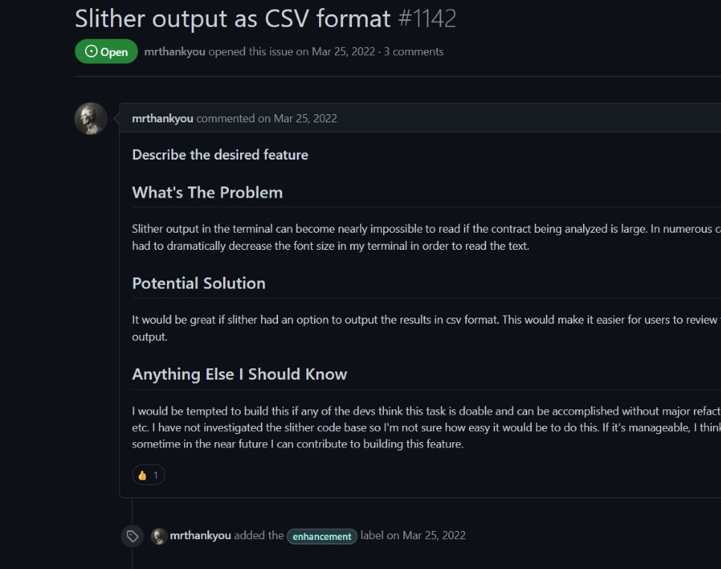
The Issue
https://github.com/crytic/slither/issues/1142

Slide 4
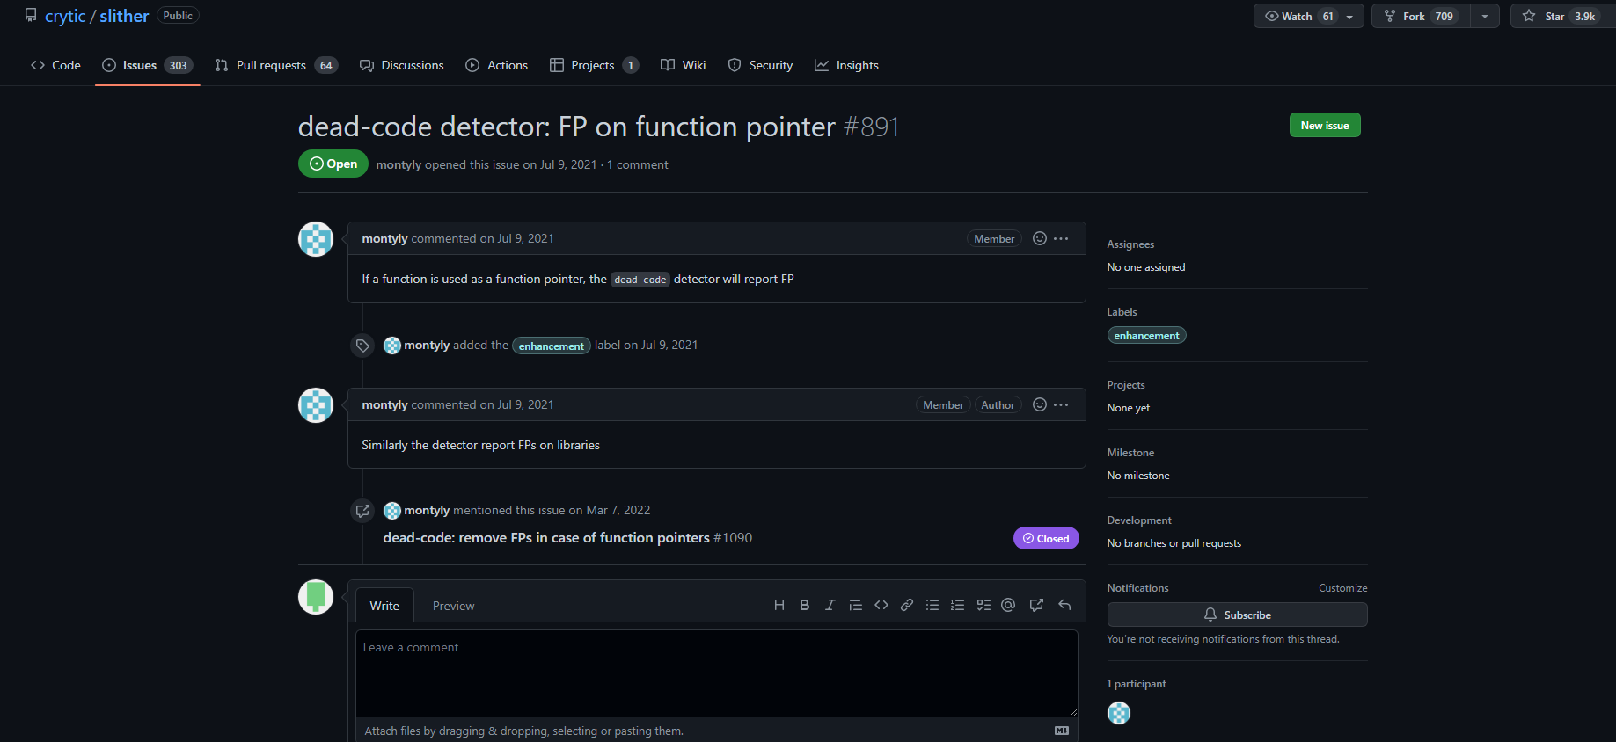
The Issue(contd.)
https://github.com/crytic/slither/issues/891

Slide 5

Input and output
We load a contract into slither analysis tool for static analysis and obtain an output as a “.json” file. We intend to convert this file format into a “.csv” format which enables us to pick and choose only the data that is pertinent to user's research.

Slide 6
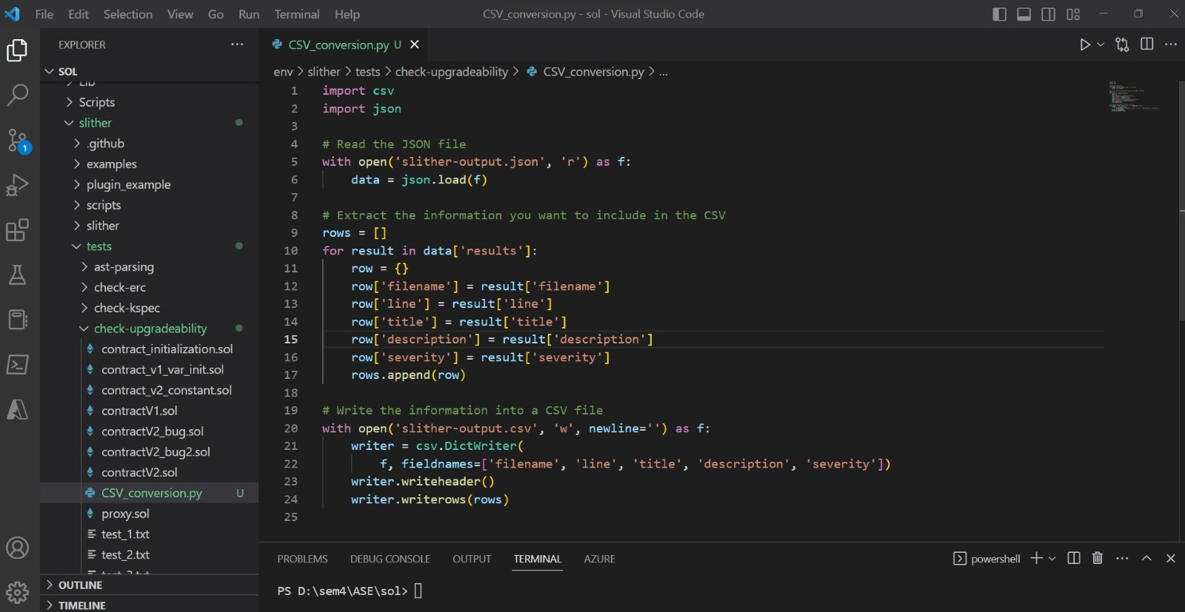
Demo/code snippets

Slide 7
competitors
Mythril
Solhint

Slide 8
What makes our solution unique?
Ease of analysis
Standardization
Customization
Integration
reducing time and effort

Slide 9
Use cases
Use Case 1- Precise Data Analysis
Basic flow- Users can use various tools and software to perform further analysis and gain deeper insights into the code being analyzed.

Slide 10
Use cases(contd.)
Use Case 2- Report Generation
Basic flow- Converting the output to CSV makes it easier to generate reports and visualizations. The data can be easily imported into various reporting tools and software, such as Excel, Google Sheets, or Tableau

Slide 11
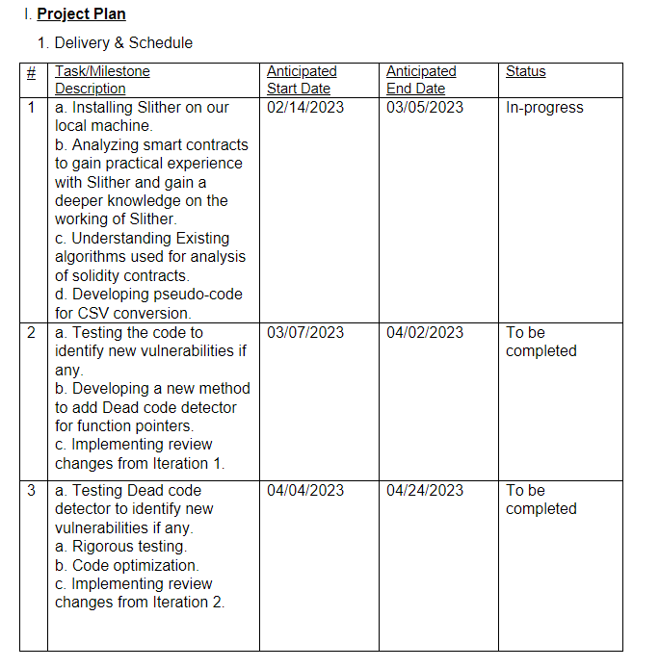
Project Plan

Slide 12
Test cases
Case 1- Verify output format
Expected output - User should be displayed with correct format and all necessary data fields
Case 2- Verify Data Accuracy
Expected output - Users should get data which is accurate and match the data generated by slither.

Slide 13
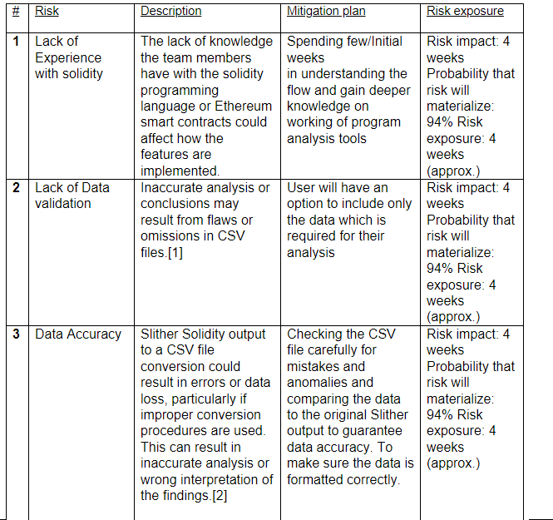
Risks

Slide 14
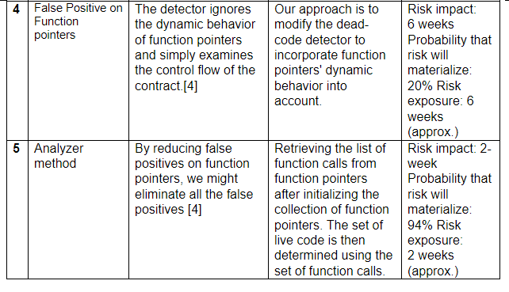
Risks(contd.)

Slide 15
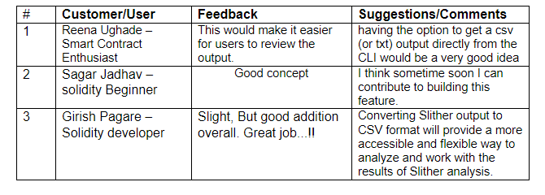
Customers/User feedback

Slide 16

Thank you! Any questions?

